Slide 1
Personal financial literacy unit 5
Dear 5th graders,
This math unit will be very different from what you are used to. If you remember last year, you learned some things that had to do with money- how to earn it, save it, spend it.
This year as fifth graders, you will be learning about the different types of ways people pay into taxes that benefit your community. You will be researching a large majority of your assignments online and you will be working with a partner for the most part.
This unit will hopefully give you a much better understanding of the economic world around you. One day you’ll be old enough to make your own money at your very own job. This unit will teach you how to manage the money you will one day earn on your own.

Slide 2
income
Day one

Slide 3
What is income?
When thinking about the word income, think of the word ‘in’. Income is the money that you earn or make while working at a job. The income you earn allows you to pay your bills, allow for expenses, and if there is any left, save.
There are numerous ways to earn income. Based on your career of choice, you will either be making a hi income or a low income.
In the next slide, you and your partner will explore a career website. This site was created by the government to help individuals better understand the type of job they would prefer to pursue.

Slide 4
Activity:
How do people earn income?
Instructions:
Click the following website
http://www.bls.gov/ooh/a-z-index.htm
Search for the following jobs in the search bar
Elementary school Teacher
Mechanic
Nurse
Police
Look for the annual income for each of the jobs and write these on your paper
Locate the educational requirements for this job and write those into your table as well.
If time permits, you may research additional jobs of your choice.

Slide 5
Taxes
Day two

Slide 6
What are taxes and why do we need them?
Taxes are the main way people pay for their government. One kind of tax is income tax. Every year, workers pay a part of their income, or salary, to the nation's government and to the government of the state where they live.

Slide 7
Income Tax
Income taxes are taken out of a worker's paycheck to pay for federal duties such as food inspection, national defense and emergency preparedness.
The amount of income tax you pay depends on how much money you make.
In other words, the more money you earn, the more you would end up paying in income tax.

Slide 8
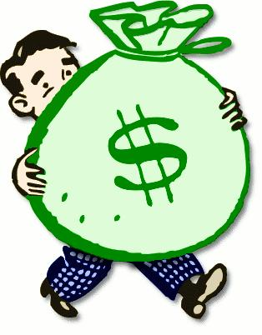
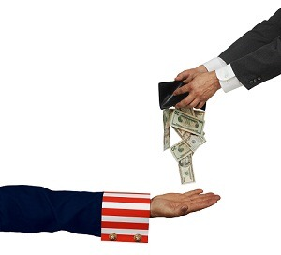
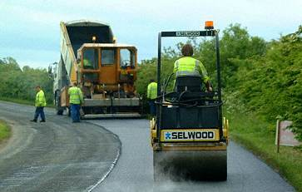
Think of it like this…

Slide 9
Sales Tax
sales tax is tagged on to the purchases he makes at a store. Each state has its own sales tax, which it uses to fund state services.

Slide 10
Property tax
Property taxes must be paid annually by anyone who owns a home or a commercial property. The property taxes that you pay are used for a number of things, and most or all of the money you pay in property tax remains inside your community. In other words, if you own a house, you must pay taxes that go towards use in your Very own surroundings.
Property tax brings in the most money of all taxes available to local government to pay for schools, roads, police and firemen, emergency response services, libraries, parks and other services provided by local government.

Slide 11
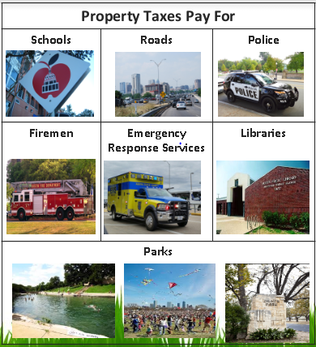

Slide 12
http://emilyross.com/news/map-of-property-tax-rate-in-austin-by-zip-code-area#PhotoSwipe1480358656427
https://smartasset.com/taxes/texas-property-tax-calculator#97ZfbZN4gf

Slide 13
Payroll Tax
Payroll taxes are deducted, or taken out, of an employees salary. These taxes are then used to pay for federal programs such as social security and medicare.

Slide 14
Gross vs Net pay
Day 3

Slide 15
Gross pay
Meet Bob!
Bob is a construction worker who builds for the city of Austin.
Bob has been working at the construction site for one year now.

Slide 16
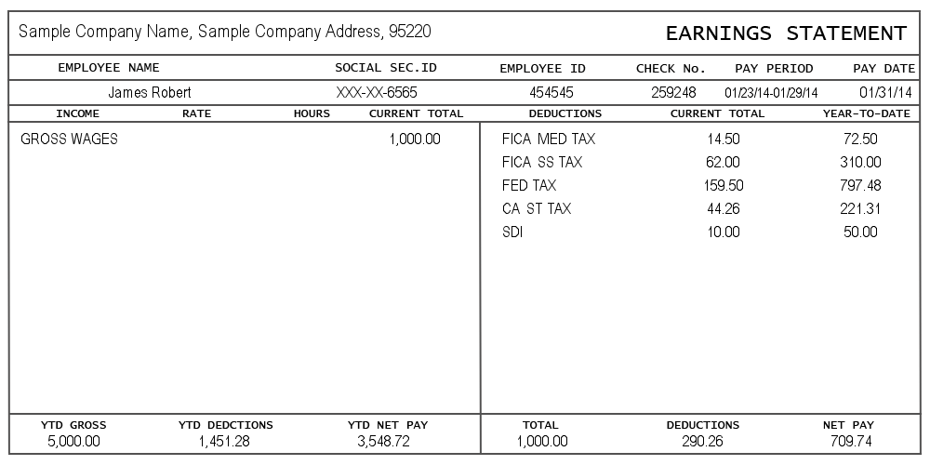
Every month, Bob receives a pay check and a pay stub. A pay stub lays out everything you’ve earned for the month.

Slide 17
Every pay stub contains the same basic information:
Name of the employee, employee ID number, and the pay period. The pay period indicates the days for which the employee is being paid for.

Slide 19
There is a section on this pay stub labeled Gross wages.
Gross wages or gross pay is how much you make BEFORE taxes and other deductions are taken out. It is the number people look for when asking how much you make in a month or in a year.
In this example, Bob earned a gross pay of $1,000 for the month.

Slide 21
This section of the pay stub is labeled ‘Deductions.’
Remember when we talked about income taxes? This is where the government takes some of the money YOU earned to pay for services.
After all deductions have been taken out, what you are left with is called NET PAY.
This is the money you can then use to spend, save or share.

Slide 22
So, Bob earned a total of $1,000. After he pays his taxes, he really only took home $709.74

Slide 23
Gross pay vs net pay activity #1
Camille Larson works for Paper Media Company. Her social security ID is 1234-678 and her employee ID is 123. This month, she will be receiving a paycheck on November 30, 2016. The check will cover the date for November 1-November 29.
During the month of November, Camille worked a total of 80 hours and gets paid $10 per hour.
On your activity sheet, fill in necessary information in all

Slide 24
Gross pay vs net pay activity #2
Camille Larson works for Paper Media Company. Her social security ID is 1234-678 and her employee ID is 123. This month, she will be receiving a paycheck on November 30, 2016. The check will cover the date for November 1-November 29.
During the month of November, Camille worked a total of 80 hours and gets paid $10 per hour.
On your activity sheet, fill in necessary information in all

